Slide 1
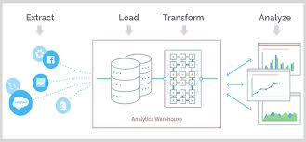

Applying ETL to the Data Job Search
Brittany Balcom
Jorge Noriega
Gayatri Sundaresan

Slide 2
Project Goals
As data analytics students, we are becoming qualified for a multitude of job titles. Rather than clutter up our browsers with multiple tabs for each job search, we can consolidate openings for different job titles with this code and see what is available in a concise yet informative table.

Slide 3





NEXT GENERATION OF ENGINEERS

Slide 4

Data Source
Indeed.com Queries:
Data Analyst
Data Scientist
Machine Learning
We targeted our queries toward these three titles due to their popularity in the data analytics job market. We kept the search isolated to jobs within 50 miles of Washington, DC.
Indeed.com has source code that is relatively friendly to basic BeautifulSoup HTML web scraping techniques. Although we were interested in acquiring data from other job sites, the web scraping required would have been more complex. This would be an interesting addition for a more sophisticated program.

Slide 5
EXTRACTION
We performed web scraping using BeautifulSoup on three different Indeed queries for data analyst, data scientist, and machine learning engineer positions, all within 50 miles of Washington, DC.
We created functions to scrape the HTML source code for job title, company name, and location, and by simply changing the search URL for each individual query were able to use the three functions to generate pandas dataframes.

Slide 6
TRANFORMATION
The dataframes were then combined using the pandas concatenate function and written to a csv file. We set verify_integrity to “True” to ensure there were no duplicates and ignore_index to “True” so that the original indices would be dropped and the combined set would have its own continuous index. Because we only scraped for the columns we wanted to include in our final data set, minimal transformation after extraction was required.

Slide 7
LOADING
After having extracted the data and cleaned the data, our final step in the process was to load the data onto a database. We thought of various ways to load our data by means of MongoDB and SqlAlchemy. We found that since our dataset was relatively manageable and that since it was organized in a CSV file we would upload the data onto a Relational Database like SQL using Postgres.
STEPS TAKEN TO UPLOAD TO SQL
1. Logged onto Postgres and created a Database ETL Project
2. Under the Query Tool wrote a script that would generate the table and defined the columns. These columns reflect exactly the columns name found under the CSV data for Job Titles.
3. Once script was created ran the script.
4. Once the columns appeared under the tables, created a View section so the table would be viewed properly

Slide 8
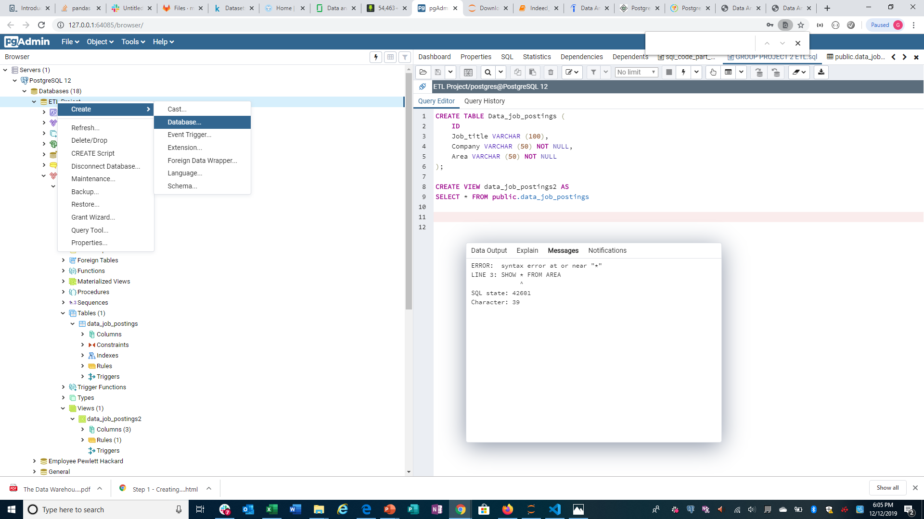











LOADING OF DATA ON SQL
Step 1:
Log onto Postgres and create a database in order to upload document

Slide 9
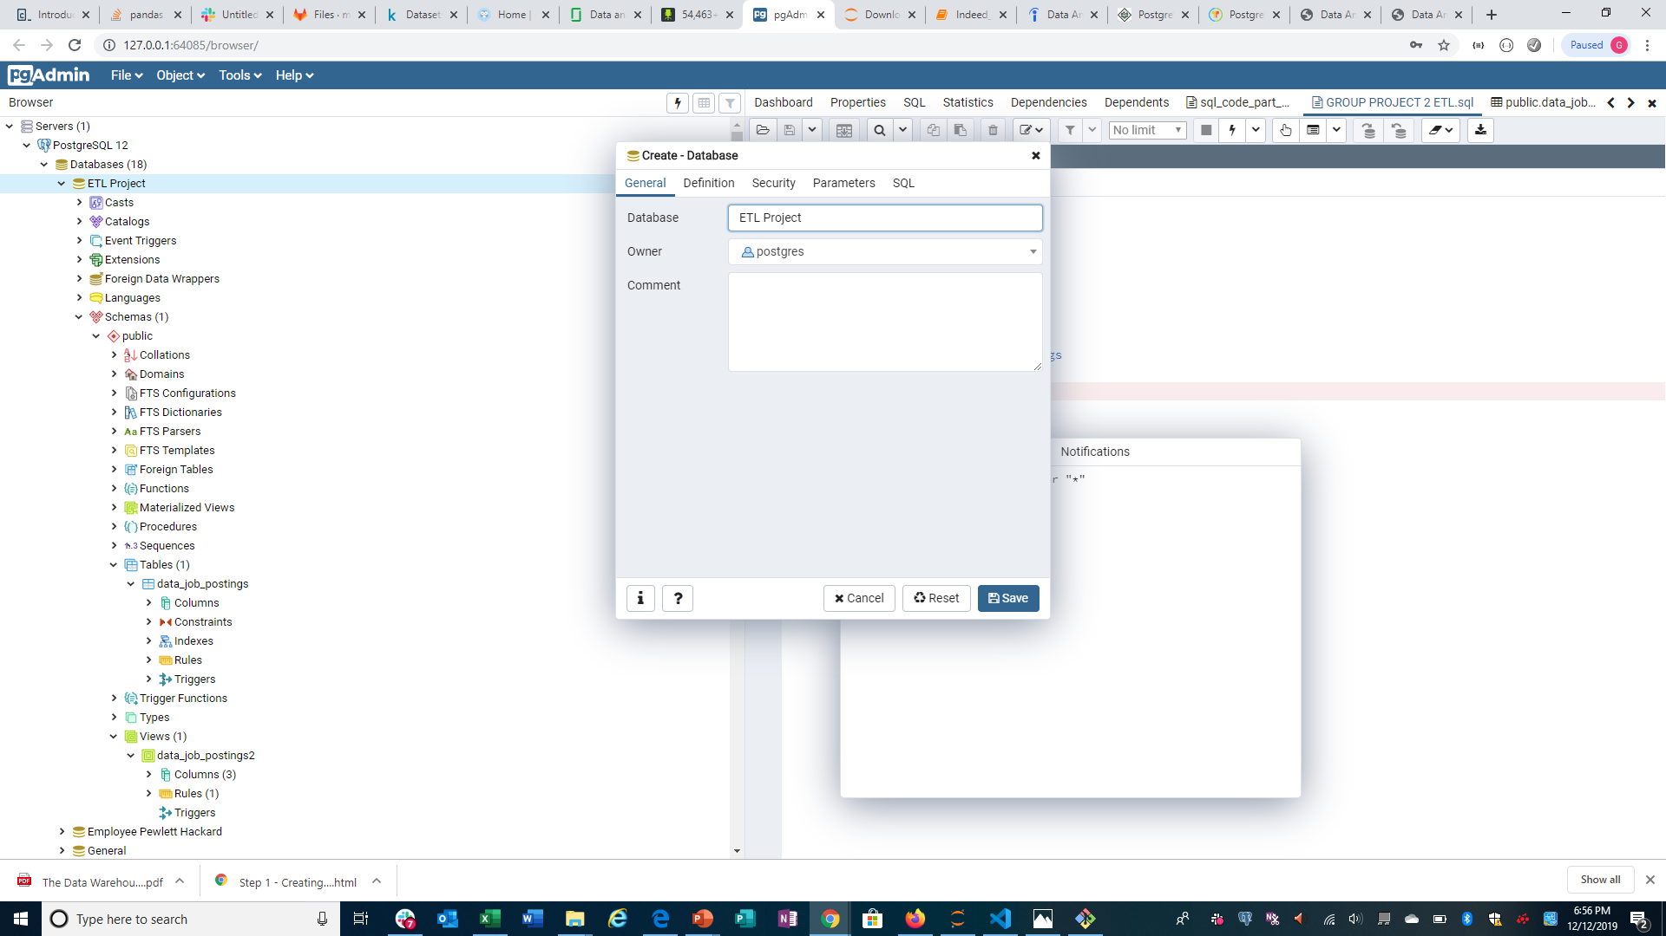


LOADING OF DATA ON SQL
Step 2 :
Type a name for the database and save it onto the system.

Slide 10
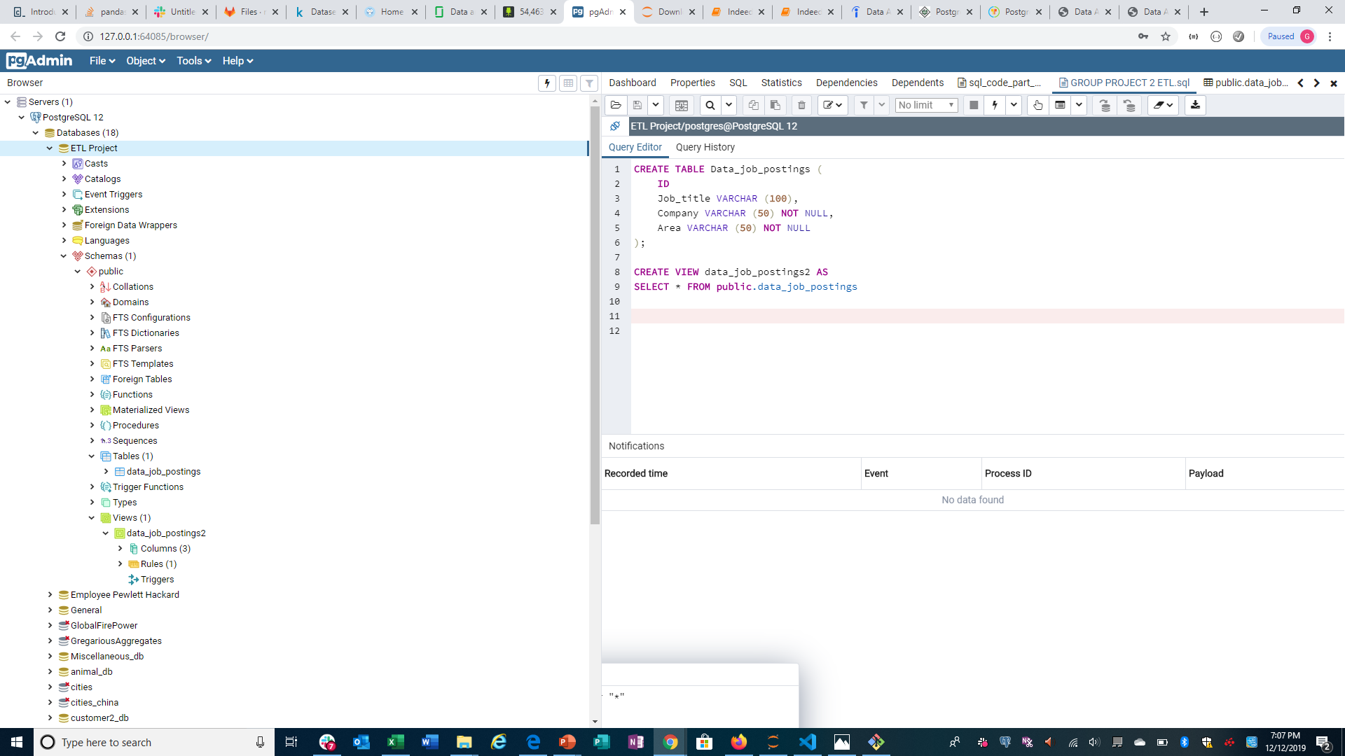


LOADING OF DATA ON SQL
Step 3:
Under the Query Tools in the database we typed a query to create a table name and the column names that are found on the CSV file being uploaded.
Once written we hit the run function to enable the Table and the columns to populate.

Slide 11
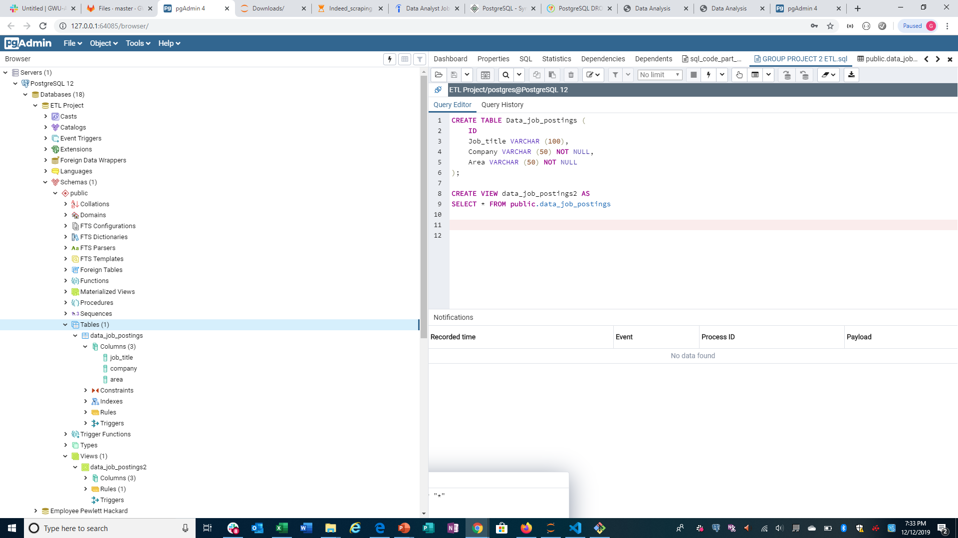

LOADING OF DATA ON SQL
Step 4:
Once the query is run we made sure the Table Name was created and the columns were also created.

Slide 12
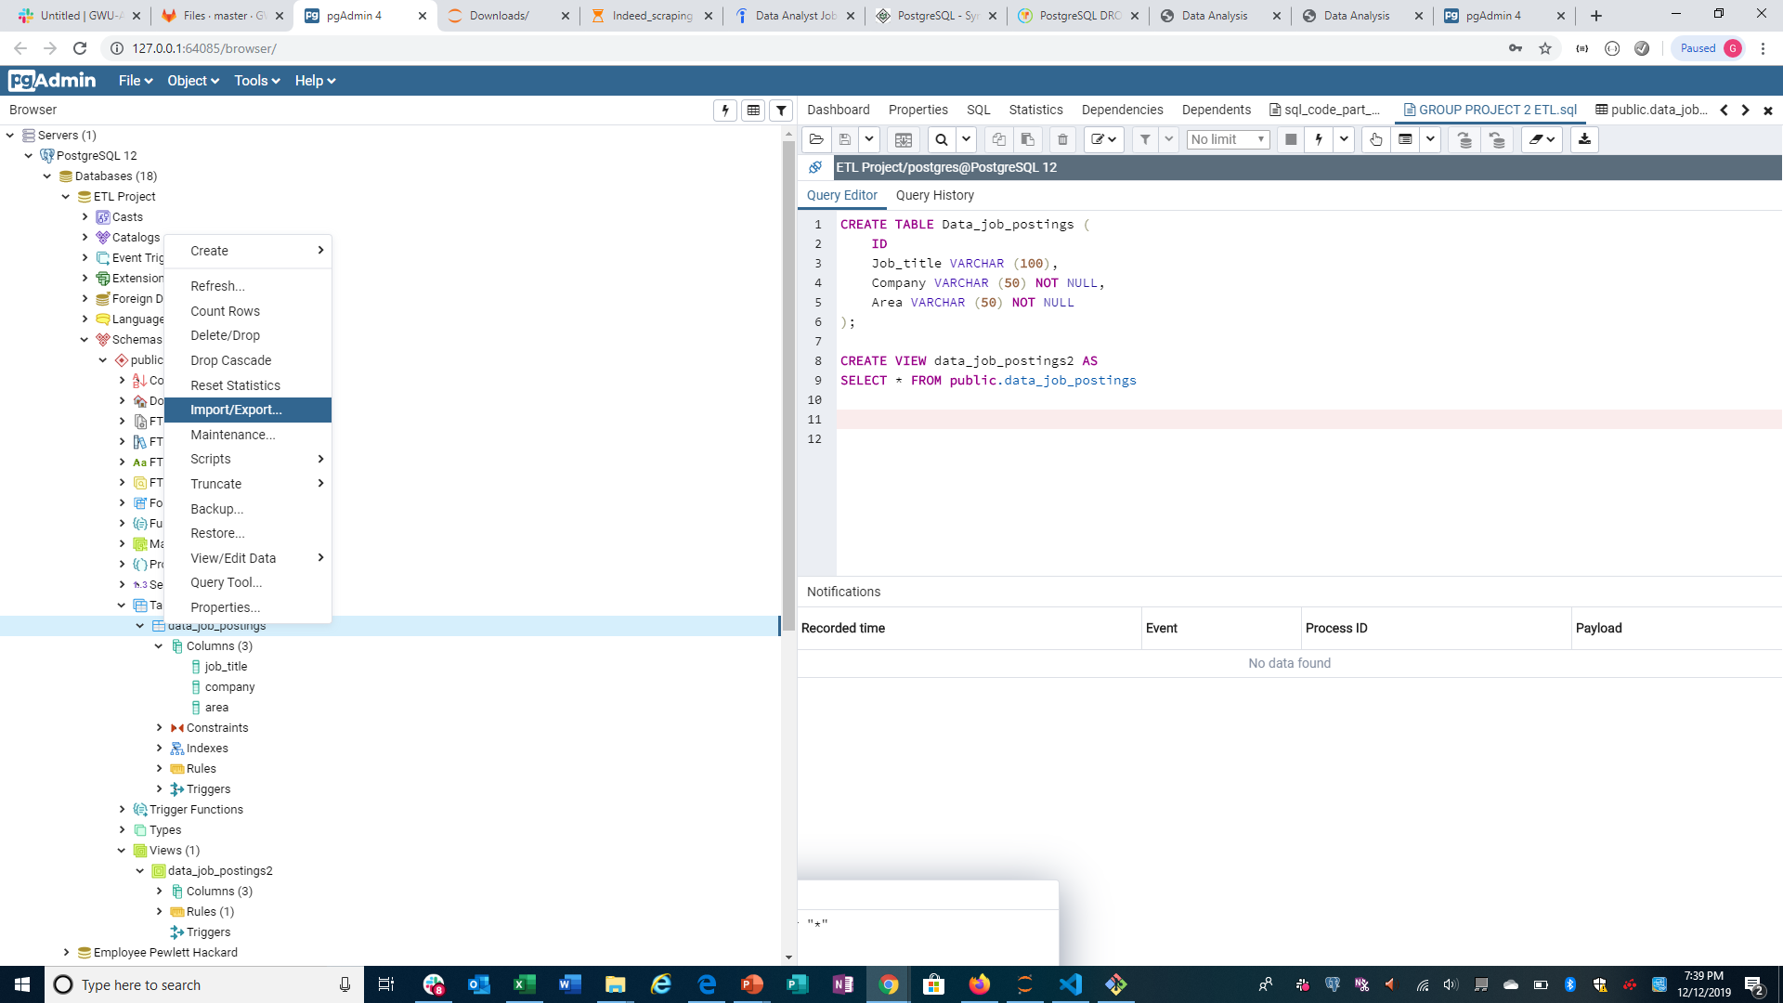

LOADING OF DATA ON SQL
Step 5:
Under the table click we right clicked and found a list of functions. We selected the Import/Export function

Slide 13
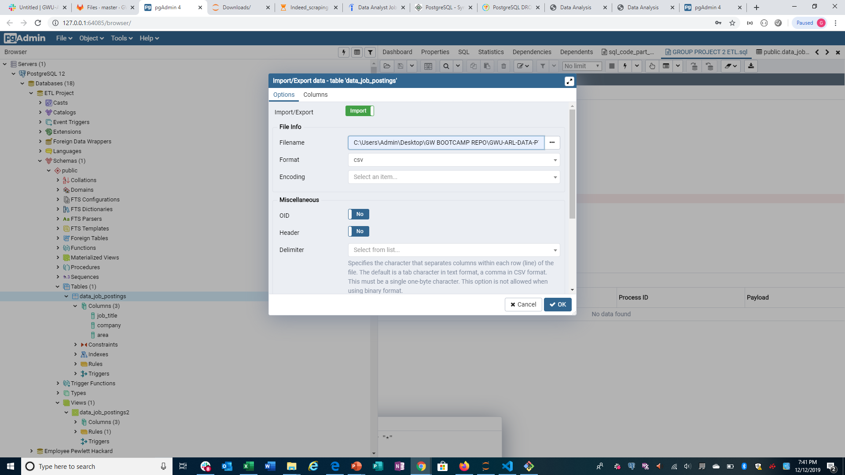


LOADING OF DATA ON SQL
Step 6:
We selected Import under Import/Export and chose the filename from our computer location.
Select OK

Slide 14
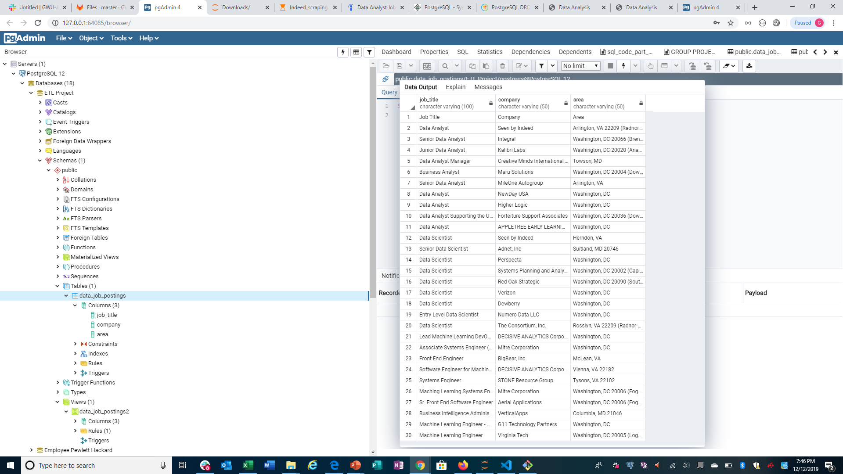
LOADING OF DATA ON SQL
Step 7:
Once the import has been successfully uploaded onto the table. We can view Data Output.
The data has been successfully uploaded onto the database in SQL Postgres

